Slide 1
Novice Programmers
Lecture Series.
Fahad S. Ahmed, MBBS, MD, ABAIM

Slide 2
Lectures
Lecture 1: Computer literacy
Lecture 2: Programming Languages
Lecture 3: Python coding 1: Basics
Lecture 4: Python coding 2: Files and folders
Lecture 5: Python coding 3: Statistics and graphs
Lecture 6: Python coding 4: Basic Machine Learning

Slide 3
Lecture 2: Programming Languages

Slide 4
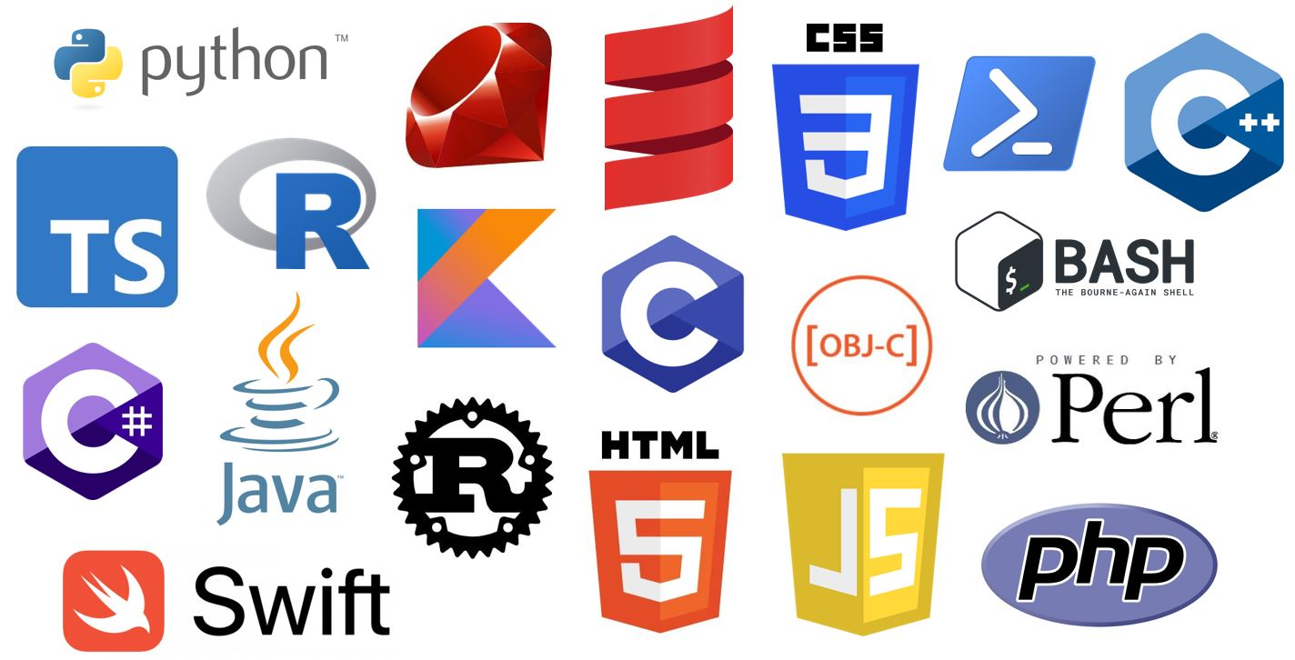
Introduction to Programming Languages
Definition: Programming languages are sets of instructions used to communicate with computers and create software.
Role: They enable humans to write code that computers can understand and execute.

Slide 5
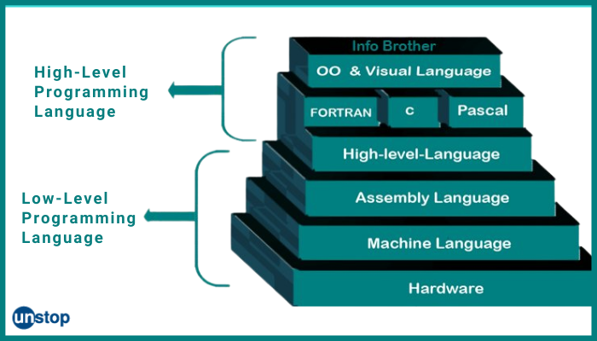
High-Level vs. Low-Level Languages
High-level languages are more human-readable and abstract, while low-level languages are closer to machine code.
Examples of high-level languages: Python, Java, C#
Examples of low-level languages: Assembly language, machine code

Slide 6
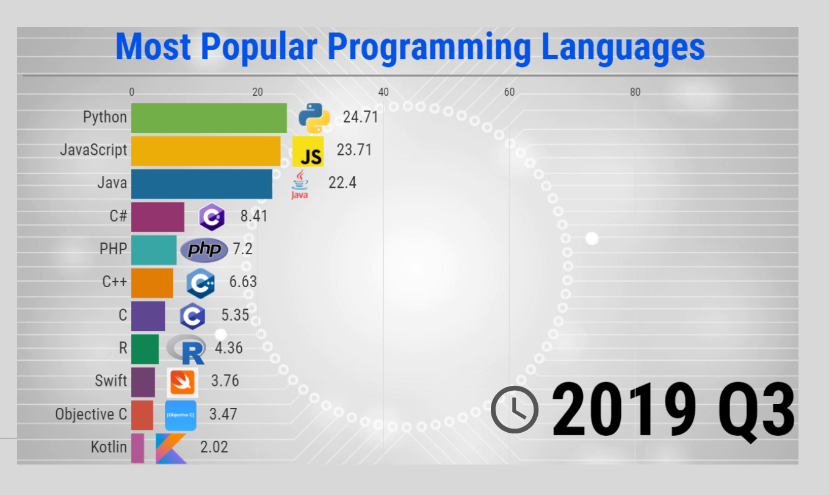
Popular Programming Languages
Python: Known for its simplicity and versatility.
JavaScript: Used for web development and adding interactivity to websites.
Java: Widely used for building cross-platform applications.
C++: An extension of C, used for system-level programming and game development.
C#: Developed by Microsoft, used for Windows applications.

Slide 7
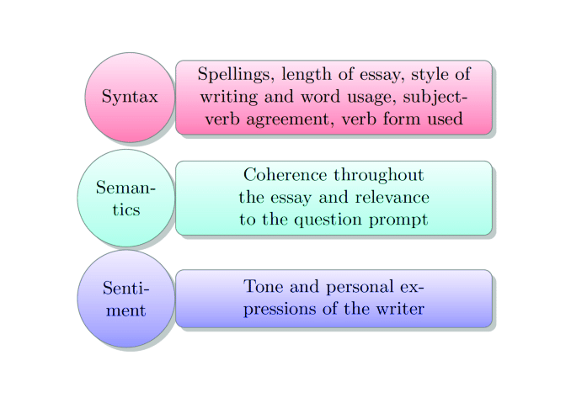
Syntax and Semantics
Syntax: Rules that dictate how code should be structured.
Semantics: The meaning behind code instructions and how they affect program behavior.

Slide 8
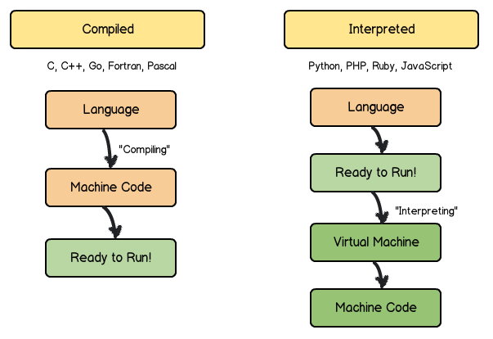
Compiled vs. Interpreted Languages
Compiled languages are translated into machine code before execution (e.g., C++).
Interpreted languages are executed line by line by an interpreter (e.g., Python, JavaScript).

Slide 9
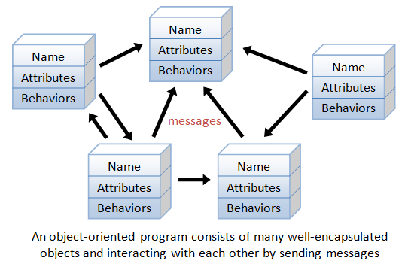
Object-Oriented Programming (OOP)
OOP is a programming paradigm that organizes code around objects and classes.
Examples of OOP languages: Java, C++, Python.

Slide 10
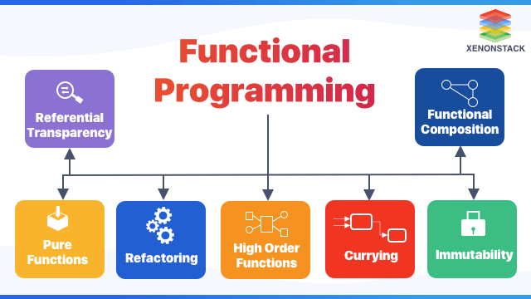
Functional Programming
Functional programming focuses on treating computation as the evaluation of mathematical functions.
Examples of functional languages: Haskell, Lisp, Erlang.

Slide 11
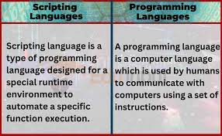
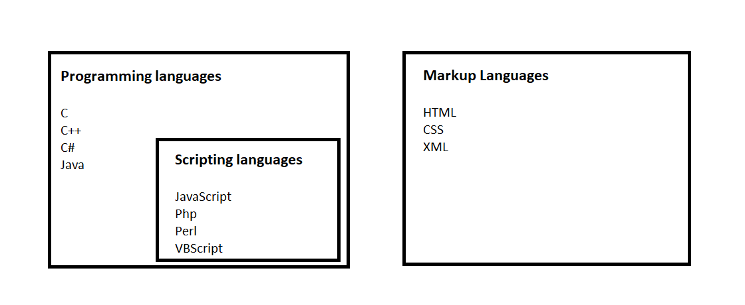
Scripting Languages
Scripting languages are used for automating tasks and rapid prototyping.
Examples: Python, Ruby, Perl.

Slide 12
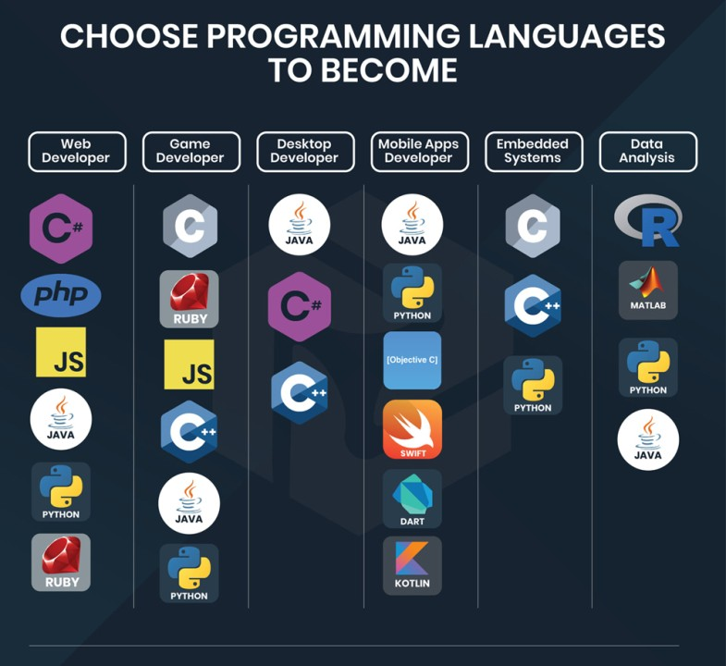
Choosing a Programming Language
Consider factors like project requirements, community support, ease of learning, and job market demand.
No one-size-fits-all language; choose based on your goals and the problem you're solving.

Slide 13
Next time
Lecture 3: Python Introduction

